Slide 1
PRESENTATION ON BLACK FRIDAY PROJECT
Under the supervision of Mr. Shwetank Mishra
Presented By
Suneel Kumar

Slide 2
Problem Statement
A retail company “ABC Private Limited” wants to understand the customer purchase behaviour (specifically, purchase amount) against various products of different categories. They have shared purchase summary of various customers for selected high volume products from last month. The data set also contains customer demographics (age, gender, marital status, city_type, stay_in_current_city), product details (product_id and product category) and Total purchase_amount from last month.
Now, they want to build a model to predict the purchase amount of customer against various products which will help them to create personalized offer for customers against different products.

Slide 3
EDA Steps
1) Check data shape(Num. of Rows, Num. of Columns)
(550068,12)
So there are 550068 Rows and 12 Columns.
2) Check each data type of columns and missing Values
So from data.info, we get all the information related to data types, and after observing all data types they are all ok.
And after observing all values from columns there are missing values, so we treat the missing values by mean for continuous data and mode for the categorical data.
3) Change the data types
After all observations, the data looks good we have done change in Stay_In_Current_City_Years as it represent numerical values but in datatypes it show object we so treat that column datatype.

Slide 4
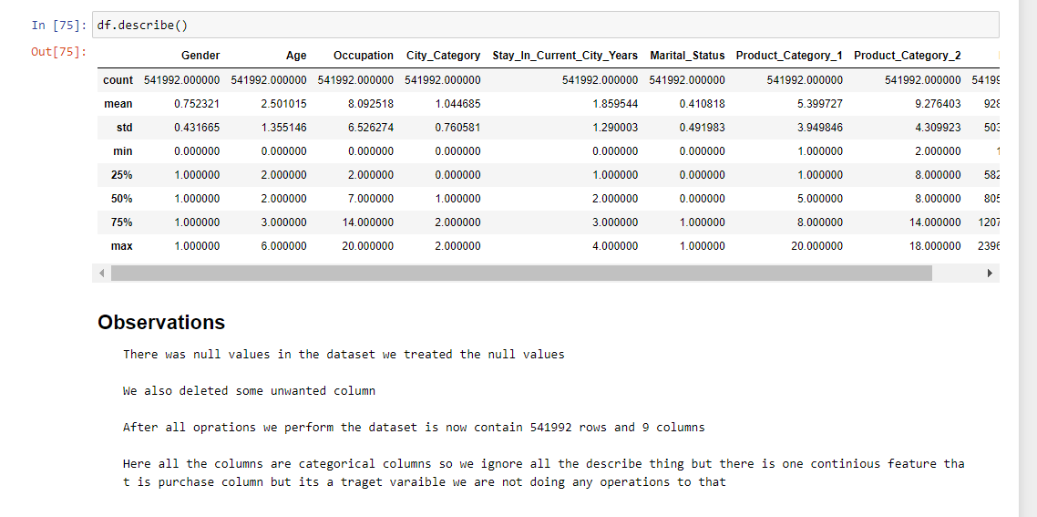
4) Summary Statistics
From this, we can see the data distribution that you have for each and determine whether there are outliers or not.
5) Check Duplicate values
Here we have observe that there are some duplicates are presnt so we dropped that duplicates by df.drop_duplicates(inplace=True) method.

Slide 5
From the above bar graph, we observe the count of the male is more than female where the count of the male is 407752 and females is 134240.
From the above bar graph, we observe there is a range of age ranging from 0 to 55+ and the most count or the people present most is of age ranging from 26-35 age followed by 36-45 age and 18-25 age and the count for that age group is 216095, 108693 and 97587.

Slide 6
From the above bar graph, we observe the occupation of the people and the people are mostly from occupation 4 with 70274 people and the least amount of people are from occupation 8 with only 1536 people.
From the above Bar graph, we observe there are 3 city category and most of the people is from the B city category with 227377 people followed by the C city category with 169417 people and the least is from the A city category with 145198 people.

Slide 7
From the above bar graph we observe most of the people stay in the current city for 1 year is most which means most of the people are new cummer and we observe next is from 2 to 4+ years the count of the people stay in the current city is decreasing.
From the above bar graph, we observe most of the people are single around 319332 people, and 222660 people are married.

Slide 8
From the above bar graph, we observe there are around 20 categories in Product_Category_1, and the count which most is for 5,1,8 categories with the count of 146496, 139489, and 111933, etc.
From the above bar graph, we observe there are around 17 categories in Product_Category_2, and the count which most is for 8,14 categories with the count of 231507 and 54599, etc.

Slide 9
From the above bar graph, we observe the age group and purchase with additional information on gender and we observe that in each category male purchase is greater than female.
From the above bar graph, we observe the age group and information of gender and we observe that in each category male count is more than the female, especially in the age group 26-35 age group.

Slide 10
From the above bar graph, we observe the city category and purchase with additional information on age group and we observe that in each city category, the purchase history of all different age groups is different there is no trend.
From the above bar graph, we observe that city category and Gender information we already know that the male count is greater than the female count but the count of the male from B city category is followed by C city category and last A city category and this is same for female.

Slide 11
From the above bar graph, we observe the total sum of money spent by each age group around 39.8 % of purchases came from the age group 26-35 followed by 20.2% of purchases came from the age group 36-45 and around 17.8% purchase came from the age group of 18-25.
From the above bar graph we observe the total sum of money spent by each age city category around 41.4 % of purchases came from the B city category followed by 32.8% of purchases came from the c city category and around 25.8% of purchases came from the A city category.

Slide 12
The Set Of Assumptions Related To The Problem Under Consideration
1] After Filling in all the null values by mean and mode, I dropped some nan values which I fill it is unnecessary, and Dropped some features that have missing values of more than 50%.
2] For this particular problem I have assumed that the Maximum VIF should be 5, if any of the features has a VIF which is greater than 5 we should drop that feature.

Slide 13
Steps
1) first we identify null values and fill the null values by using mode mehod
2) then I identified duplicates and I have dropped duplicates
3) performed EDA and wrote all observations for each graph
4) then i dropped unnecessary columns
5) then applied a label encoder to the categorical columns
6) then also plotted the Distribution plot and regression plot
7) then plotted boxplot to remove outliers
8) then treated outliers with the Z-score method
9) then scaled data and Also check for VIF
10) then find the co-relation between feature and label by the CORR method
11) then created 4 models that is Gradient Boosting Regressor, Random Forest Regressor ,linear Regressor model, Ada Boosting regressor model with hyperparameter tuning for all 4 models and also Cross-validations
12) At last I selected the best model according to their Hyper-parameter score and Training(R2) and testing score(R2)

Slide 14
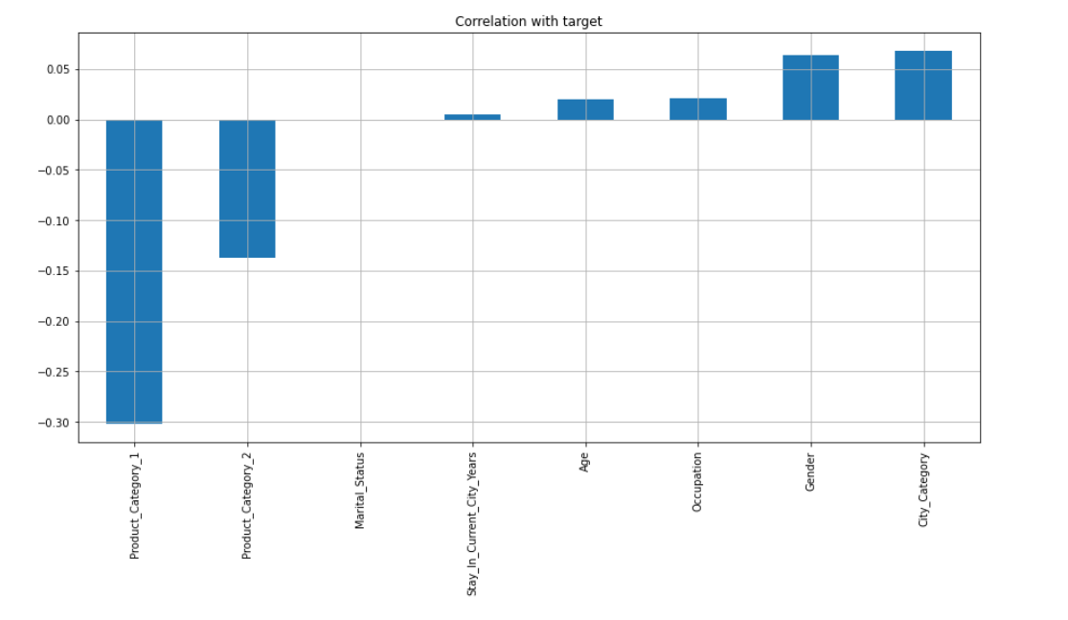
These are all the features that are positively co-related to the label and Negatively Co-related to the Label

Slide 15
Testing of Identified Approaches (Algorithms)
LR (Linear Regression Model)
GBDT (Gradient Boosting Regressor Model)
RF (Random Forest Regressor Model)
ADA (AdaBoost Regressor Model)

Slide 16
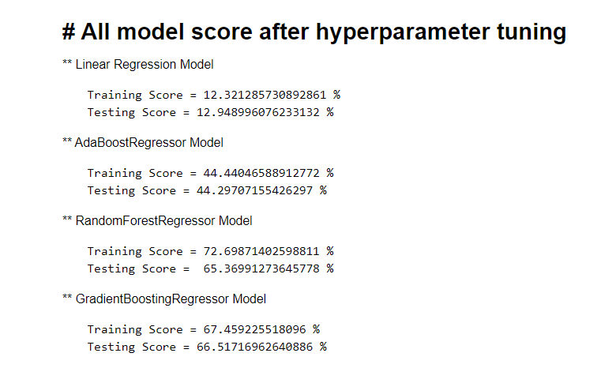
These are 4 Models Which I selected to predict the Sales prices and after hyperparameter tuning, we Find that Gradient Boosting Regressor is the best-suited model and so selecting Gradient Boosting Regressor Model.

Slide 17
CONCLUSION
So from above all 4 model scores, we observe Gradient Boosting Regressor Model is best Suited model for this particular model as the training score is 67.459225518096 % and the testing score is 66.51716962640886 % thus saving this model.

Slide 18
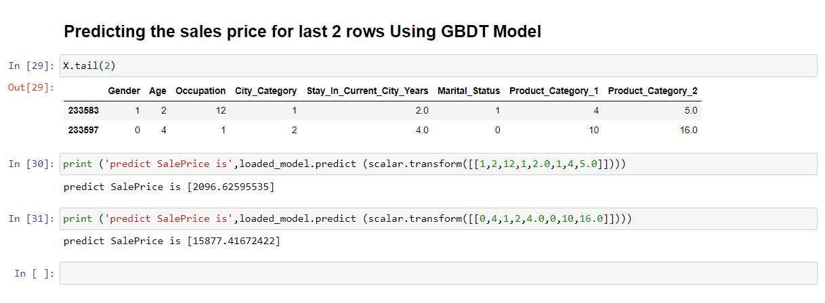
After Selecting Gradient Boosting Regressor we have Done Prediction On test data but for Last 2 columns

Slide 19
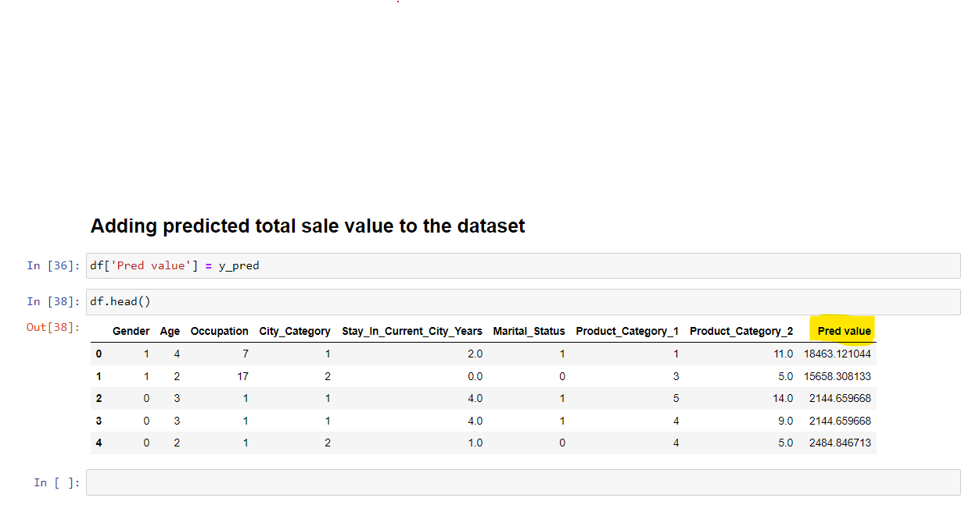
Adding predictive value to the dataset

